Slide 1


Learning Lab
StartVaardig
Lisa Dumaij
19049838
Yuliya Litvin
20161417
Mustafa Mousa
18068987
Pascal Seegers
21132844
Joost van Viegen
18048757
Joep van der Zanden
19134282
t-SNE
Motoric Skills Development

Slide 2
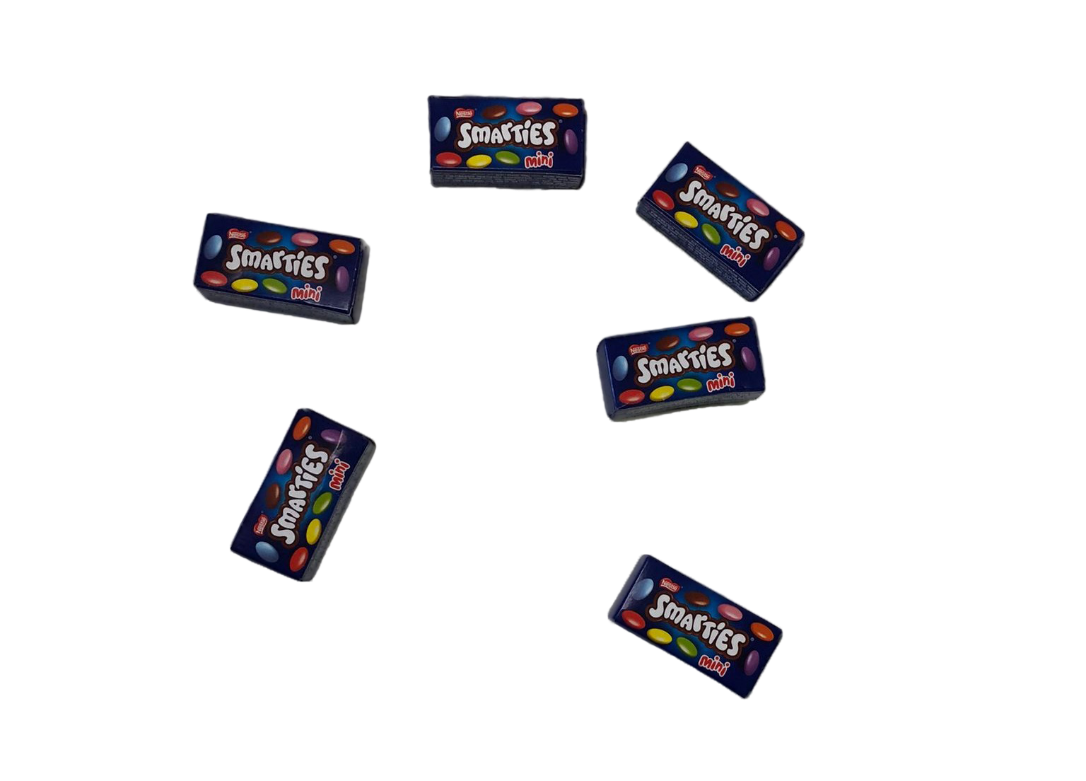
1
Notes:
"What do smarties and a t-SNE have in common?"

Slide 3
T-SNE
2

Slide 4




3
What is t-SNE
T-distributed stochastic neighbor embedding
Visualizing high-dimensional data
What is it for
Data exploration
Data visualization
Identifying non-linear connections
3

Slide 5

4
How does it work?
Gaussian distribution
Cauchy distribtution
Kullback-Liebler divergence
4
Notes:
https://towardsdatascience.com/an-introduction-to-t-sne-with-python-example-5a3a293108d1
Explain shortly what these are.

Slide 6
3
What is t-SNE
T-distributed stochastic neighbor embedding
Visualizing high-dimensional data
What is it for
comprises two main stages:
probability distribution over pairs of high-dimensional objects
defines a similar probability distribution over the points in the low-dimensional map,
1

Slide 7
4
Why can it be helpful?
Data understanding
Data exploration
Cluster detection

Slide 8

3
Advantages
Identify clusters
Helps understand data
Dimension reduction
Disadvantages
Understanding parameters
Choosing parameterization
5

Slide 9
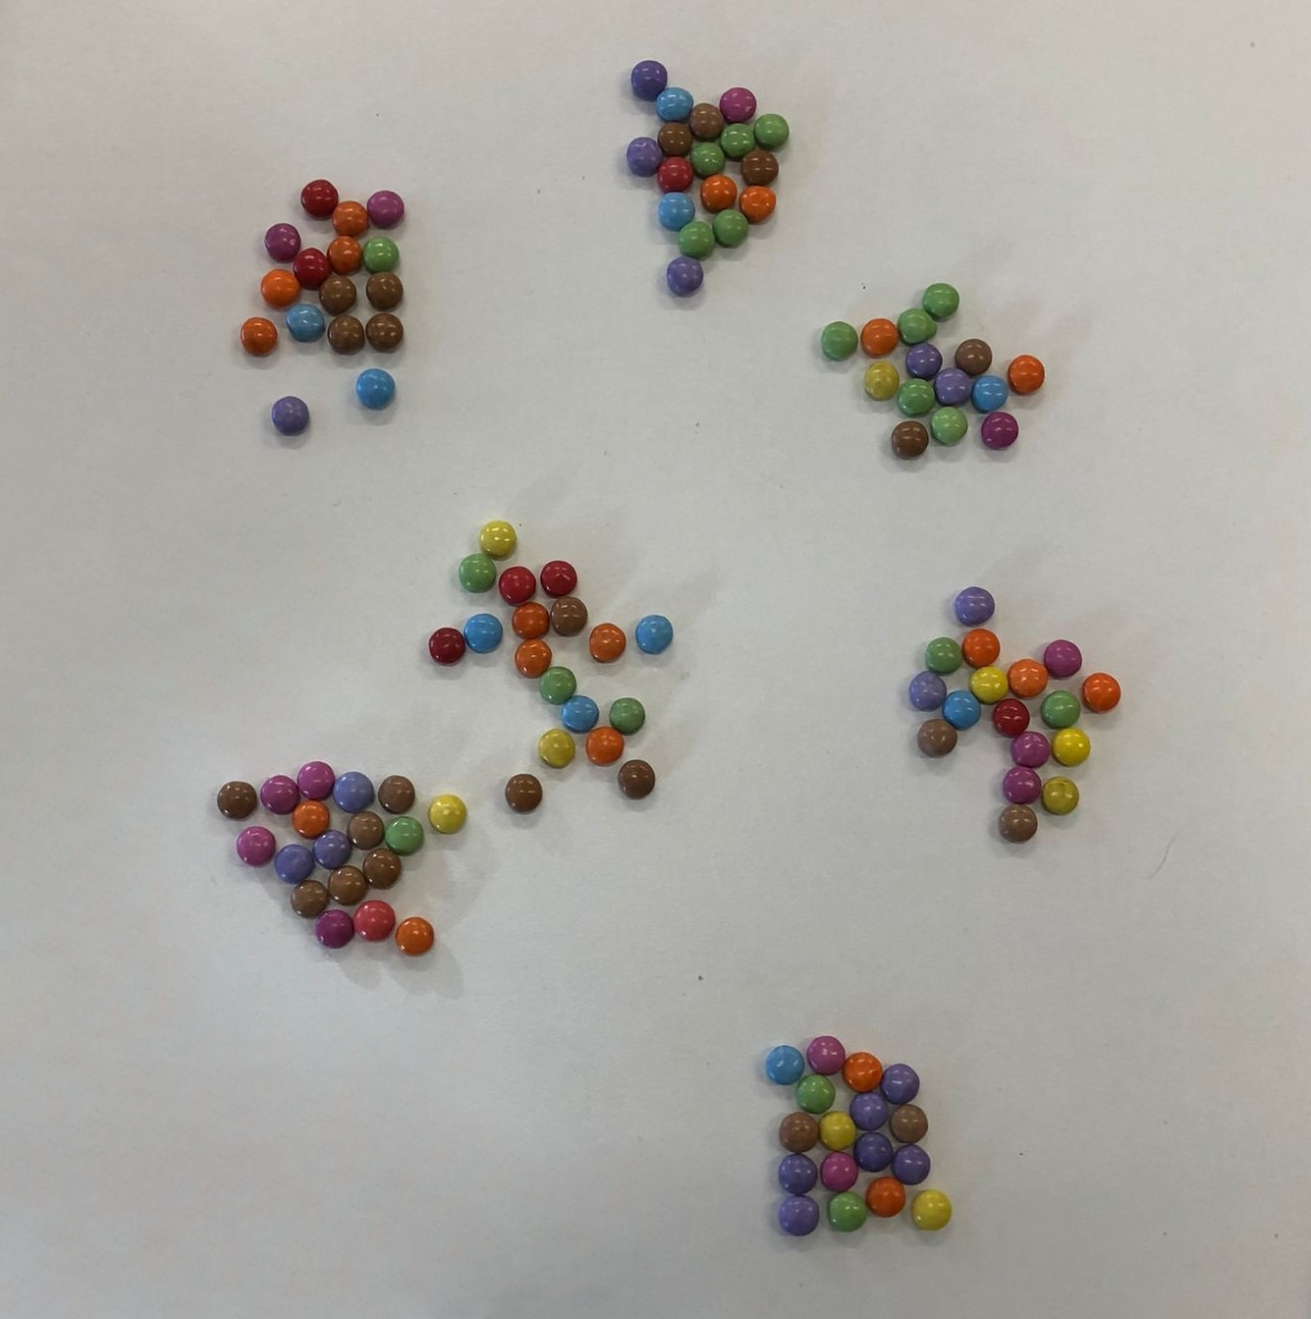
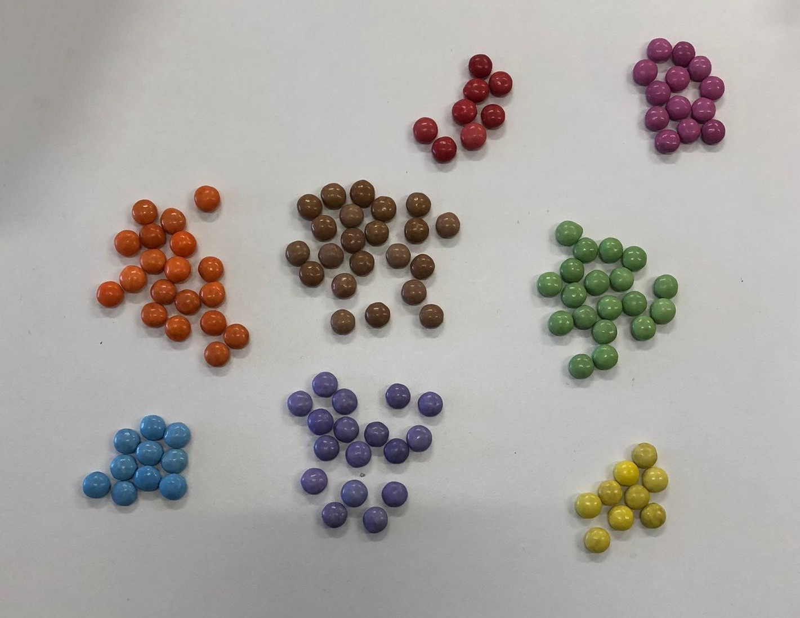
5
Fig 1: t-SNE without fine tuning
Fig 2: t-SNE with fine tuning
Problems
6

Slide 10
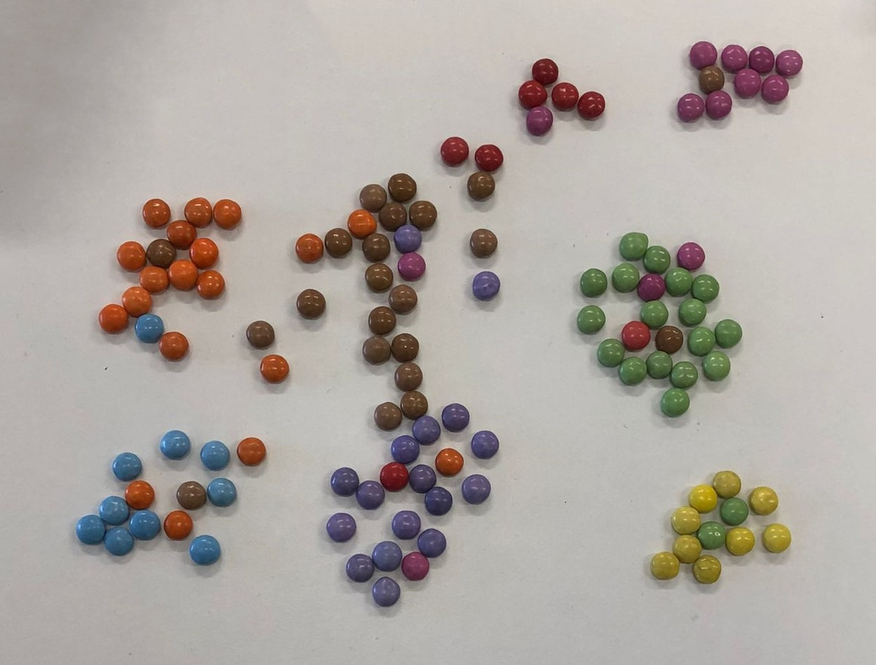
5
Fig 3: normal t-SNE
Problems
7

Slide 11
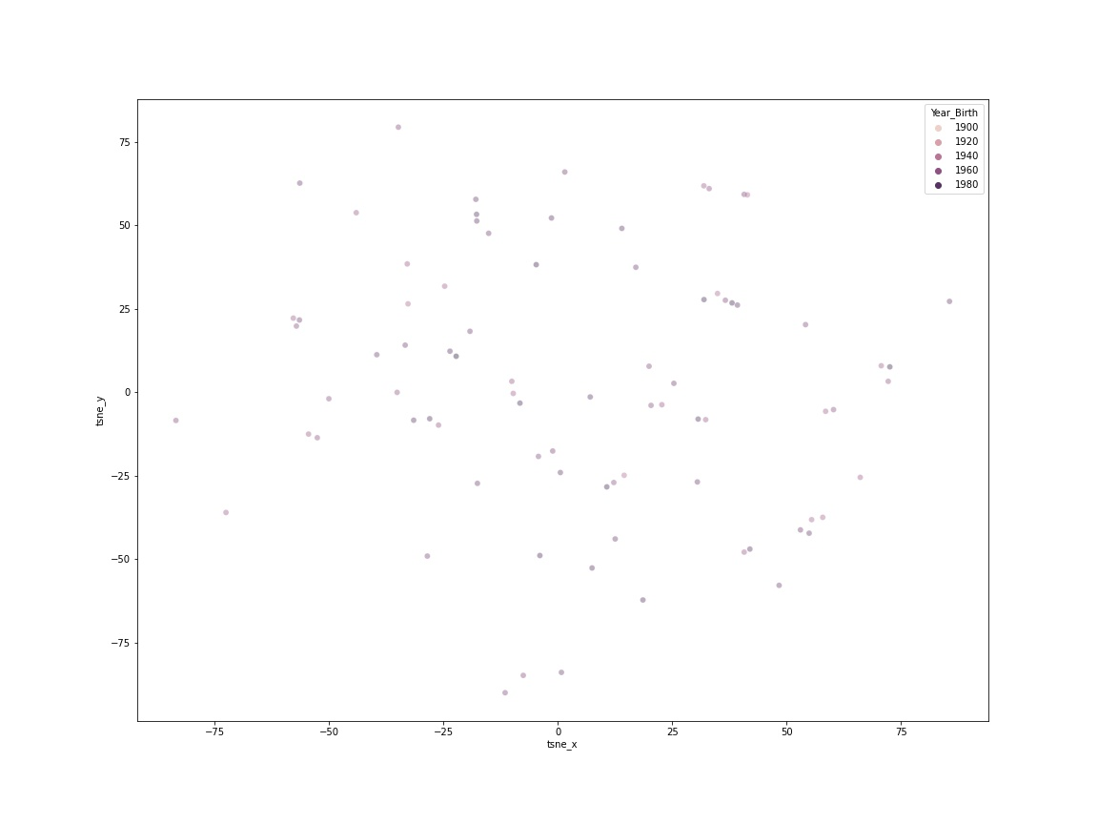
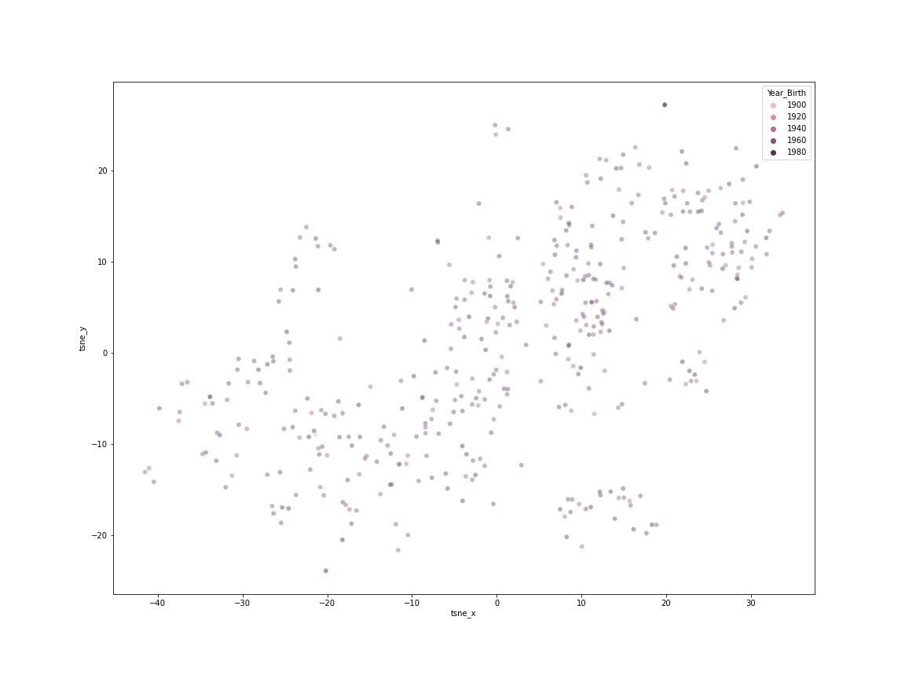
5
Fig 3: Perplexity: 2
Fig 4: Perplexity: 100
Parameters
8

Slide 12

4
Needed steps
Encode strings
Scale data
Unscale data
9
Notes:
https://towardsdatascience.com/an-introduction-to-t-sne-with-python-example-5a3a293108d1
Explain shortly what these are.

Slide 13



code
10

Slide 14
5
Calculation

Slide 15
5
Visualize it

Slide 16
5
More Examples

Slide 17
your turn
11

Slide 18


8
Your task
Code: on screen
Questions
12

Slide 19
thank you
Questions
13

Slide 20

5
References
​
Van der Maaten, L., & Hinton, G. (2008, november). Visualizing Data using t-SNE. https://www.jmlr.org/papers/volume9/vandermaaten08a/vandermaaten08a.pdf ​
Boeye, J. (2020, 20 maart). Python Tutorial: t-SNE visualization of high-dimensional data. YouTube. Geraadpleegd op 29 november 2021, van https://www.youtube.com/watch?v=85XaciPBCkw​
Wattenberg, M. (2016, 13 oktober). How to Use t-SNE Effectively. Distill. Geraadpleegd op 29 november 2021, van https://distill.pub/2016/misread-tsne/​
​
Violante, A. (2018, 30 augustus). An Introduction to t-SNE with Python Example - Towards Data Science. Medium. Geraadpleegd op 29 november 2021, van https://towardsdatascience.com/an-introduction-to-t-sne-with-python-example-5a3a293108d1
Maklin, C. (2019, 12 augustus). t-SNE Python Example. Towardsdatascience. Geraadpleegd op 29 november 2021, van https://towardsdatascience.com/t-sne-python-example-1ded9953f26 ​

